Slide 1

Radux
Global Positioning System Technologies

Slide 2
Developer Team
Johncarlo Cerna:
Project Manager, Graphic Designer, and Programmer
Chris Hoyek:
Chief Programmer
Sebastian Conde:
Graphic Design and Research Director
Andre Simoes:
CAD technician

Slide 3





Most major news organizations only publicize major news because they don’t have the capability to cover every story from every city in the world.
Unfortunately, many people don’t keep up with current events, as they see it as a boring waste of time.

Slide 4
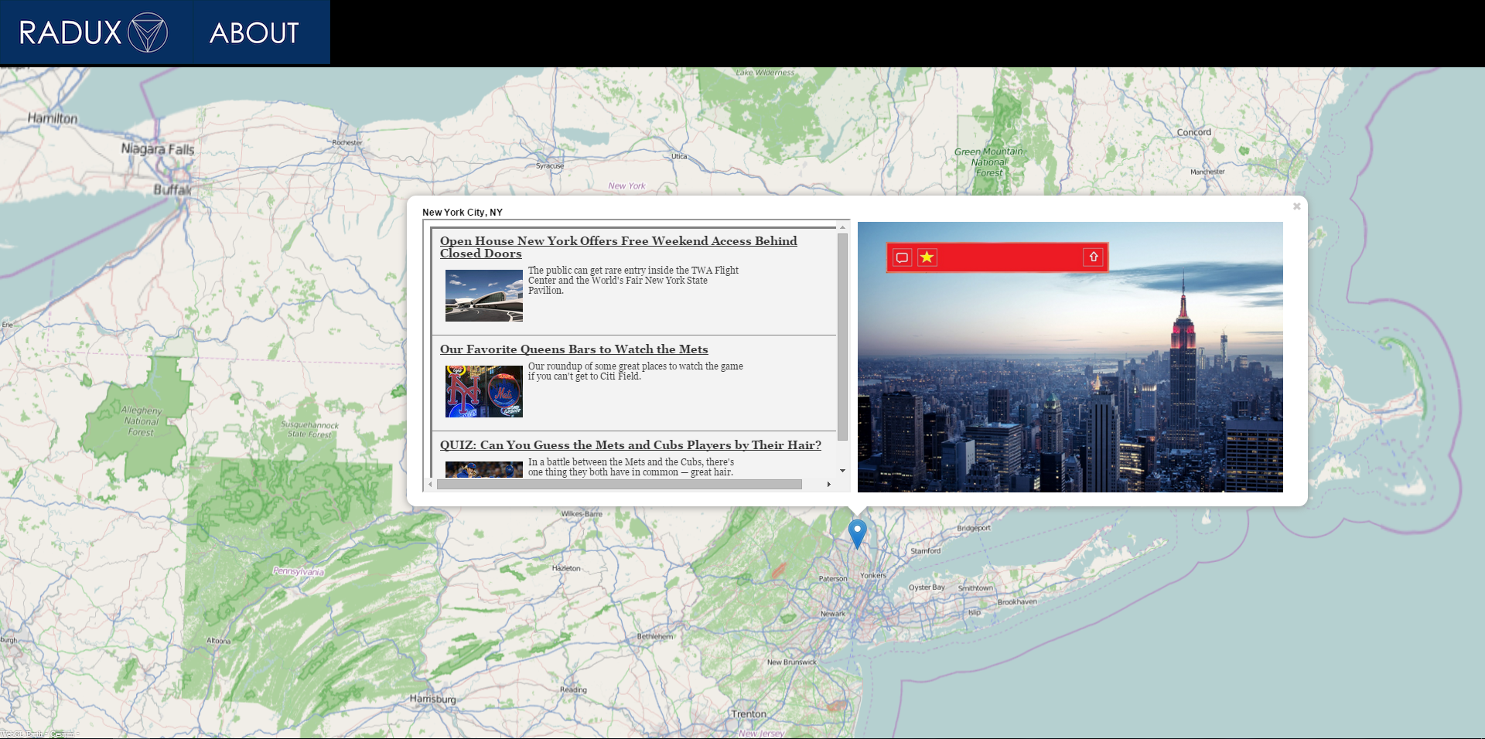
Radux is an information database that allows the user to find local or international news by simply navigating to a location on the map.

Slide 5
Our Concept
With Radux, the user can go directly to the local news of any city in the world.
The interface is very user friendly.
Both professional and civilian journalist news stories will be featured in local news.
Our early Balsamiq mockup

Slide 6
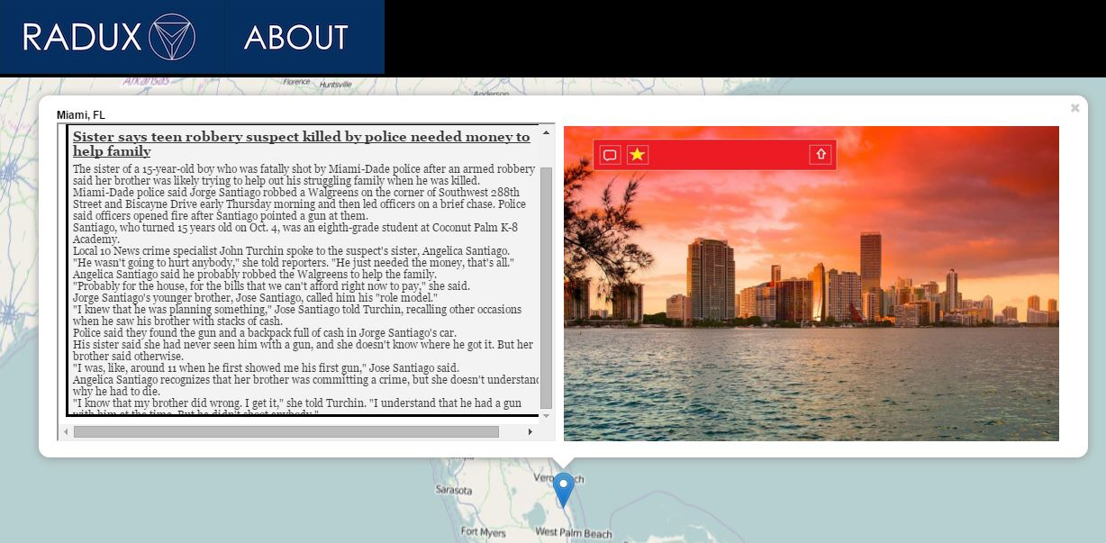
An Outlet for Everyone
Users can submit their own stories for a local area as well, from canned food drives to a football game.

Slide 7
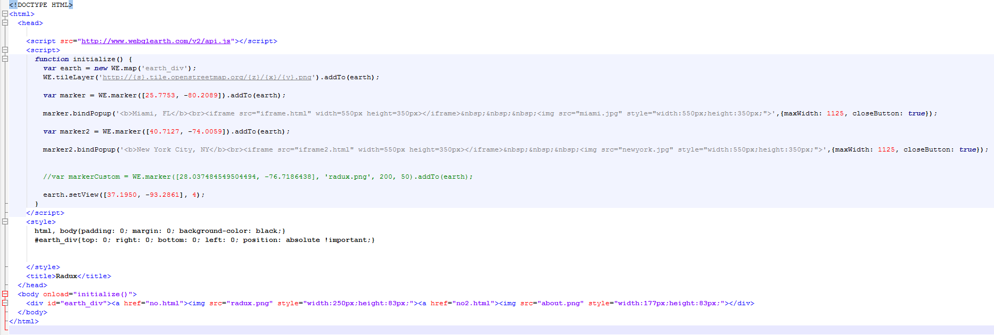
How It Works
The Map uses WebGLEarth, an open source API.
RSS codes are used to deliver news to the iFrame.
The website is coded in HTML5.

Slide 8

The Impact
Target Audience: People of all ages interested in current events.
When people participate in their community, they become happier and more productive.
As more and more people start using Radux, news outlets will gain interest and would be willing to create a partnership to deliver news in one captivating service.

Slide 9
Links
http://www.webglearth.org
http://www.qcad.org/en/
https://balsamiq.com/
https://www.flickr.com/creativecommons/
https://www.rssinclude.com/

